Slide 1
FIGHI: Fisher Information Guided Hyper-Interaction Inference
A scalable and interpretable framework for discovering high-order genomic interactions
Notes:
“Today, I’ll introduce FIGHI — a framework that extends Fisher Information theory to detect meaningful gene–gene interactions, beyond what traditional GWAS can capture.”

Slide 2
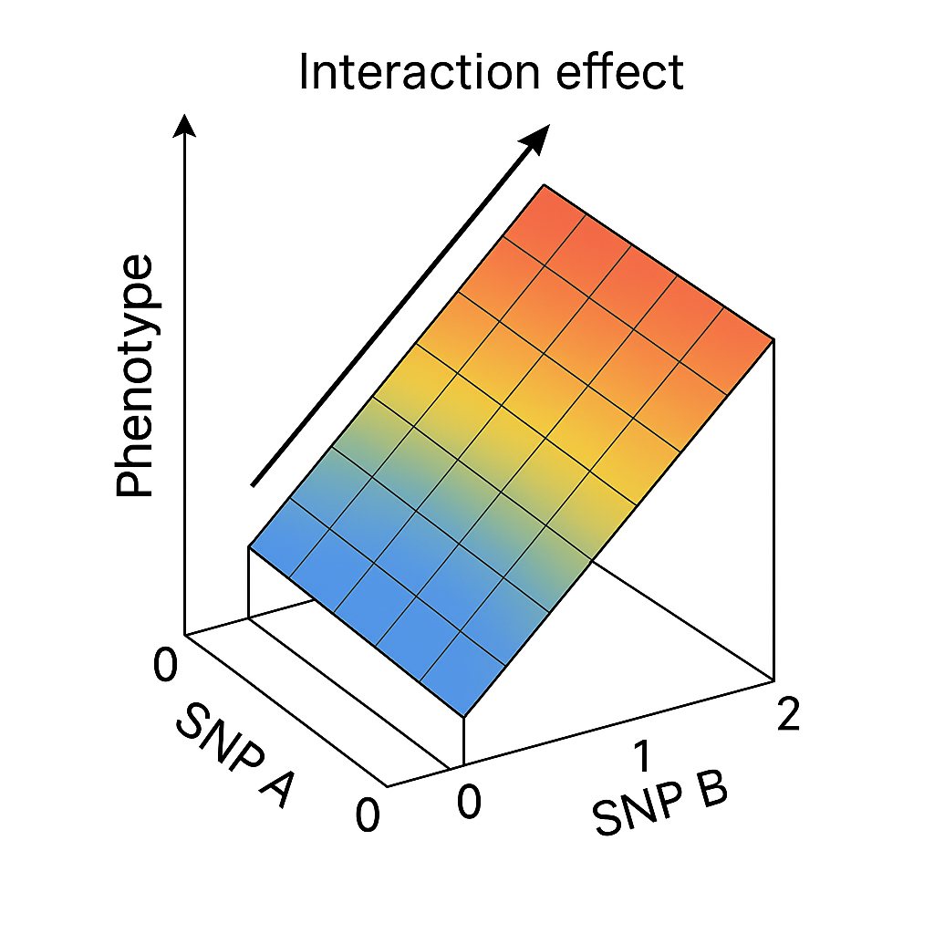
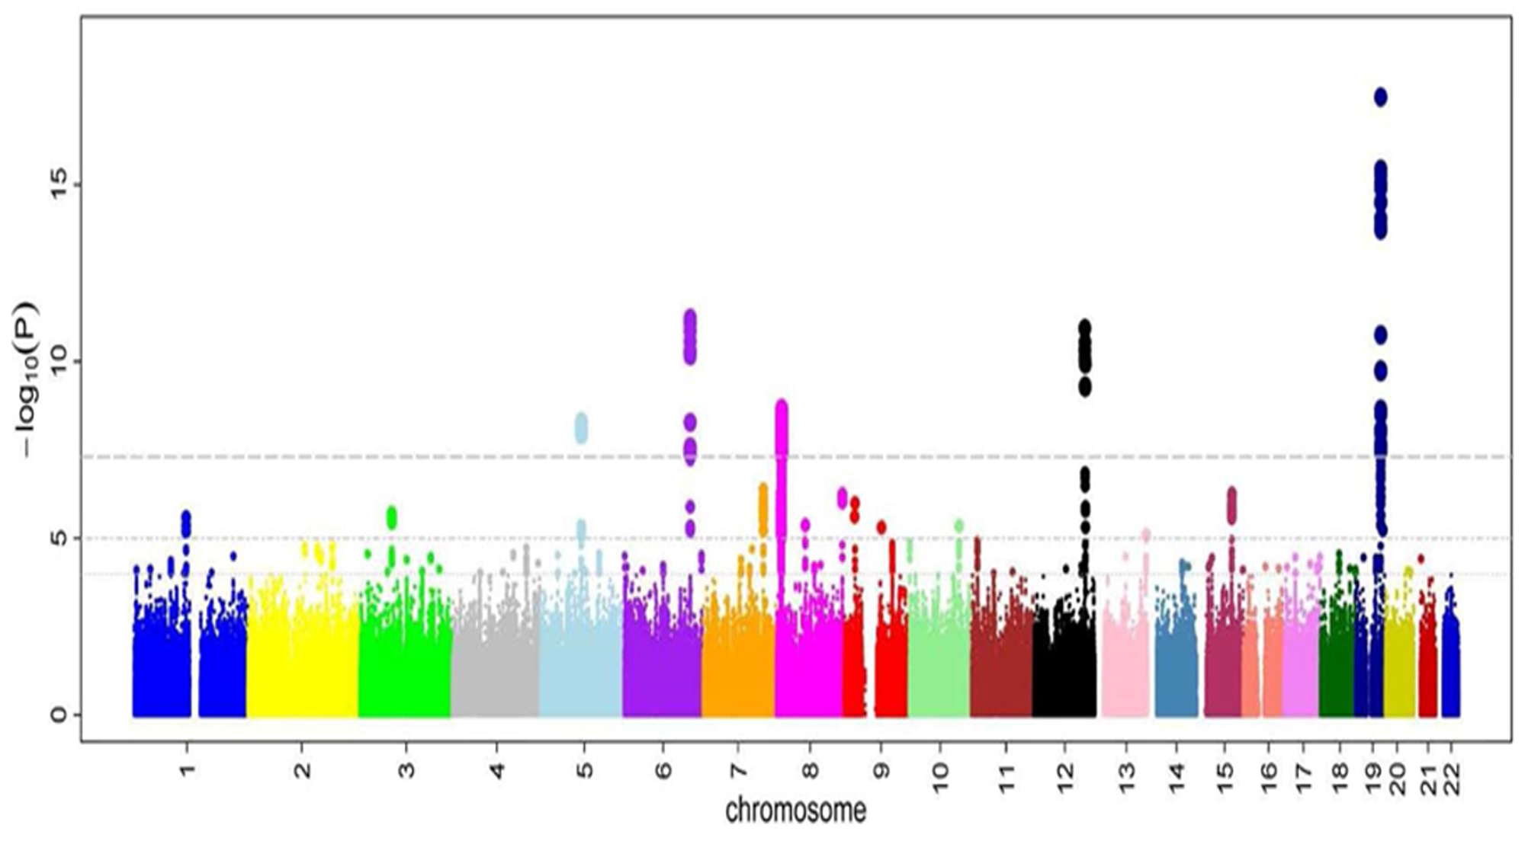
Why FIGHI?
Traditional GWAS misses interaction effects (epistasis)
Traditional GWAS tests each SNP independently — one by one — for its association with a phenotype. That’s fine for additive effects, but what if SNP A and SNP B only matter together?
Notes:
“In GWAS, we test one SNP at a time. But biological reality is combinatorial — traits often arise when variants work together. FIGHI captures that cooperation mathematically.”
Example: SNP A by itself does nothing; SNP B by itself does nothing — but A × B = 1 triggers a pathway that changes the phenotype. GWAS would miss that, because it never considers A×B jointly.

Slide 3
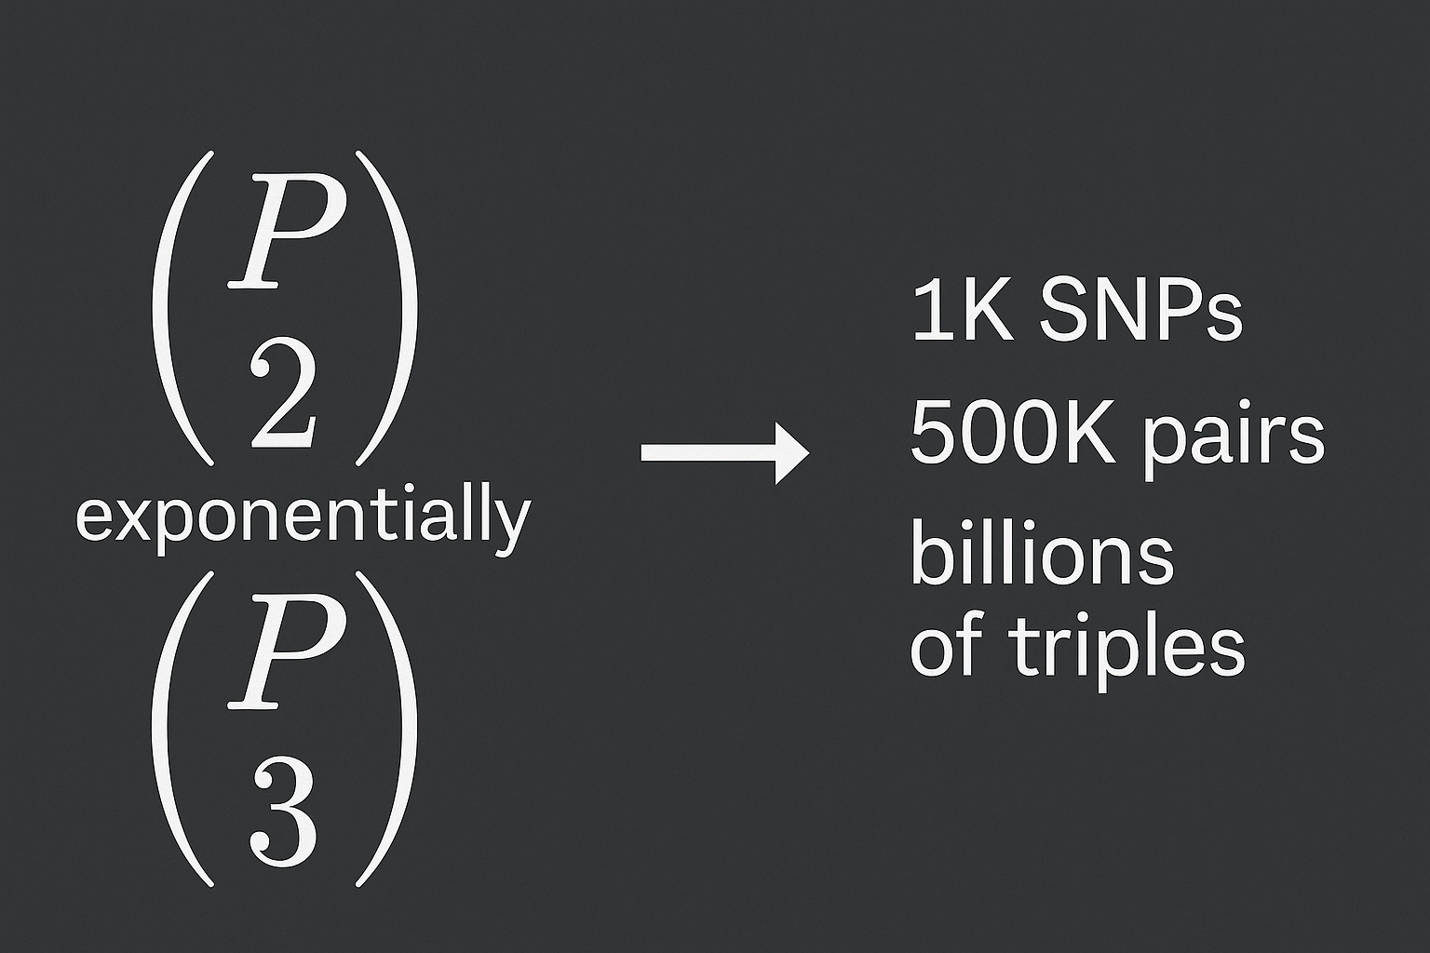
The Challenge:
The Combinatorial Explosion
Problem:
P(y∣X) may depend on interactions among SNPs.
But enumerating all possible interactions is
combinatorially explosive:
- With 1M SNPs, even pairwise
interactions = binom{10^6}{2} → impossible.
- We need a smarter way to decide which interactions
are worth testing.
So, we reformulate the question as:
“Which combination of SNPs adds the most Fisher Information about the phenotype?”
Notes:
“Even with just 10,000 SNPs, pairwise interactions explode combinatorially. We needed a way to prioritize combinations that actually matter statistically — that’s where Fisher Information comes in.”

Slide 4
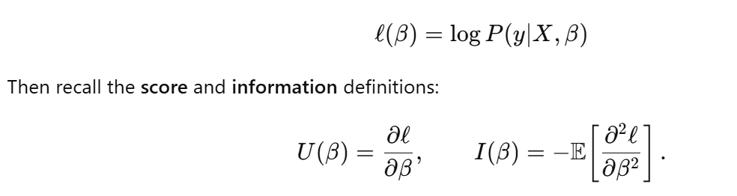
From Likelihood to Fisher Information
Interpretation:
U(β) tells how the log-likelihood changes with β (slope).
I(β) tells how stable that slope is; the curvature, or certainty.
Large Fisher Information → steeper curvature → more certainty → stronger signal.
So, Fisher Information quantifies how much certainty a parameter contributes.
Notes:
“Fisher Information measures how sharp or stable a likelihood peak is. The sharper it is, the more certain we are. So, we use this curvature as our measure of information gain.”

Slide 5

Intuitive Visualization
Geometric View of Fisher Information
Notes:
“Geometrically, each interaction causes a local curvature in the likelihood surface — a deformation that changes how the phenotype manifold bends around the genotype space.”

Slide 6
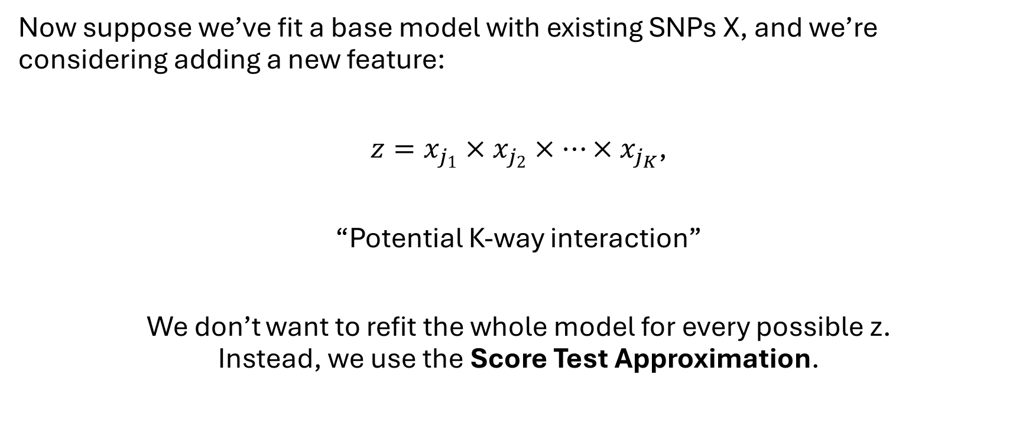
Information Gain for a New Feature
Now suppose we’ve fit a base model with existing SNPs X, and we’re considering adding a new feature:
$z=x_{j_{1}}×x_{j_{2}}×⋯×x_{j_{K}}$,
“Potential K-way interaction”
We don’t want to refit the whole model for every possible z. Instead, we use the Score Test Approximation.
Notes:
“This comes from the score test — the same principle used in classical inference — but reinterpreted for interaction discovery. We only need gradients and curvature terms, so it scales beautifully.”

Slide 7
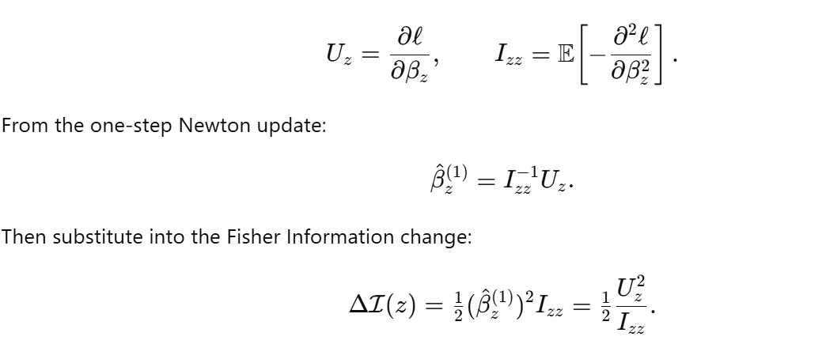
Score Test Derivation
This is the core equation of FIGHI.
Notes:
“This is the essence of FIGHI: for each potential interaction z, we compute how much additional Fisher Information it adds — that’s our signal strength — without refitting the whole model.”

Slide 8
Score Test Derivation
Interpretation
Uz: how correlated the new interaction is with the residuals
Izz​: how stable (non-collinear) that interaction is
ΔI(z) how much extra certainty this interaction adds
So, we can rank all possible candidate interactions by ΔI(z) without refitting the model for each.
Notes:
“This is the essence of FIGHI: for each potential interaction z, we compute how much additional Fisher Information it adds — that’s our signal strength — without refitting the whole model.”

Slide 9
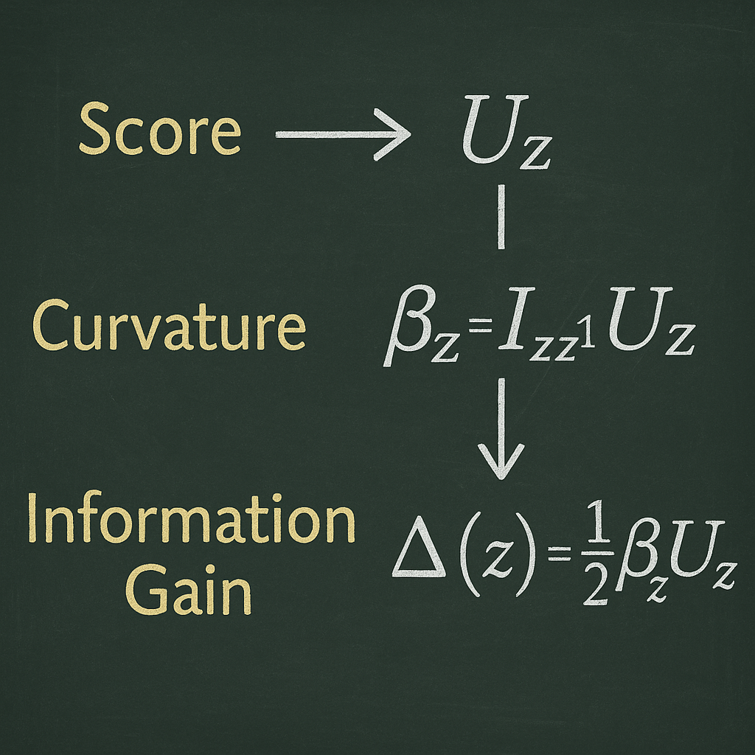
Mathematical Consistency
Score-Test Derivation & Computational Simplicity
Notes:
“This comes from the score test — the same principle used in classical inference — but reinterpreted for interaction discovery. We only need gradients and curvature terms, so it scales beautifully.”

Slide 10
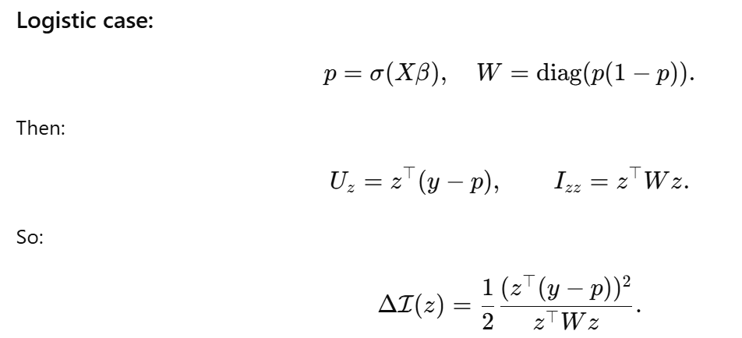
Fisher Information Gain for Logistic and Linear Models
We can derive Uz and Izz explicitly.

Slide 11
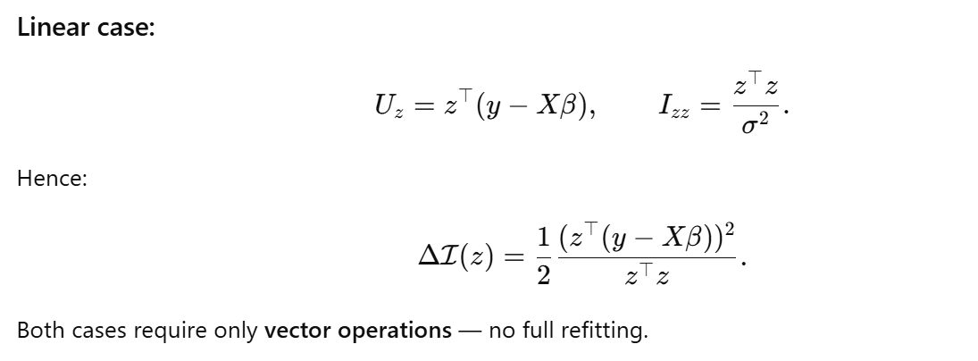
Fisher Information Gain for Logistic and Linear Models
We can derive Uz and Izz explicitly.

Slide 12
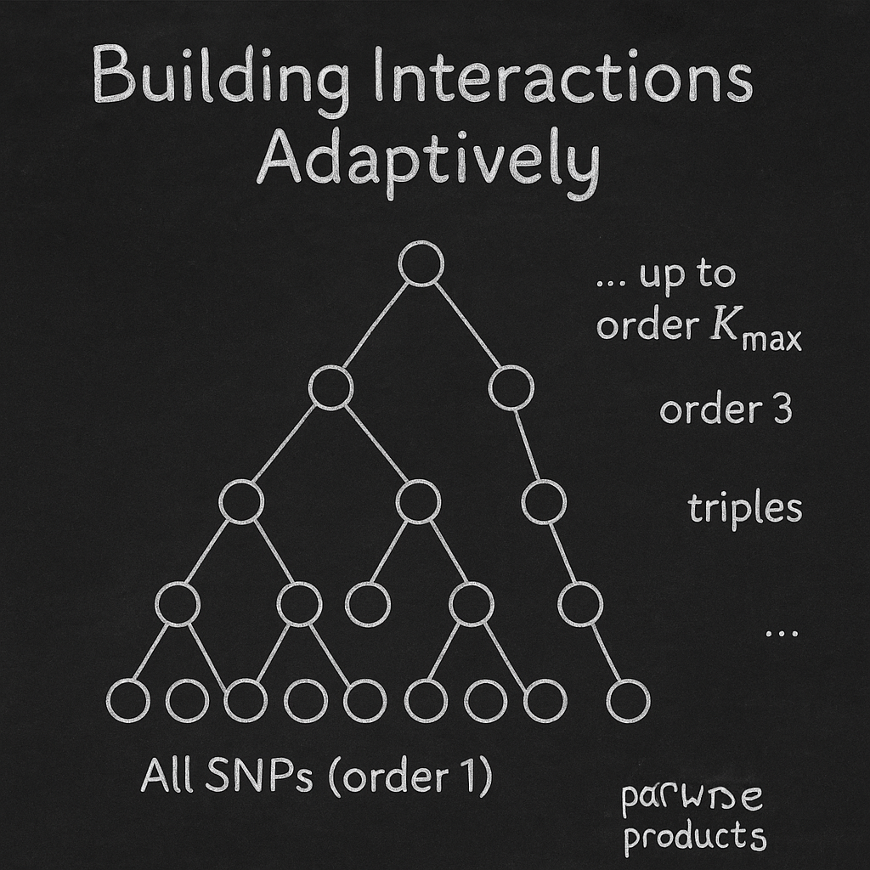
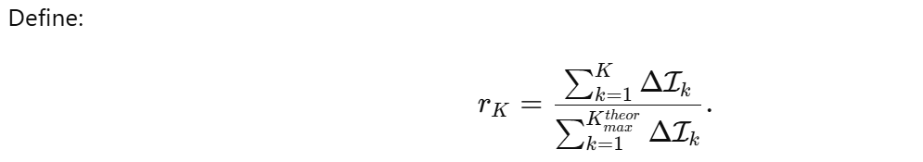
Building Interactions Adaptively
But we don’t explore everything. We keep only the interactions that add significant Fisher Information.
FIGHI adapts its order depth — if information saturates early, it stops at 2- or 3-way.
That’s why even if we set max_order=4, you may only see 2-way interactions — because that’s where Fisher Information stops growing.
When rK > threshold (say 0.95), stop.
Notes:
“We control how deep the model explores — 2-way, 3-way, or higher — using a max_order parameter. But it’s adaptive: even if we set max_order=4, the model stops where Fisher Information gain saturates.”

Slide 13
Computational Implementation
Memory-efficient pipeline.
- Reads huge genotype CSVs in chunks (read_csv(chunksize=...))
- Uses prescreening: keep only top M SNPs by correlation with phenotype
- Streams data blockwise, computes ΔI(z) incrementally

Slide 14
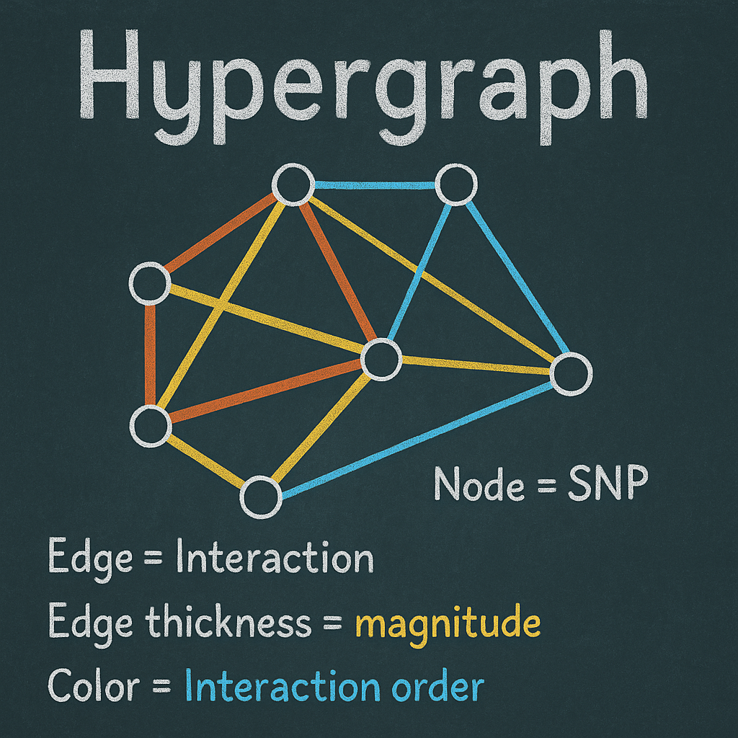
Hypergraph Representation
Say:
Each SNP = node
Each discovered interaction = hyperedge
Edge weight = ΔI(e)
So, the hypergraph encodes multi-level cooperation among SNPs.
Notes:
“We can visualize FIGHI’s output as a hypergraph — where edges connect SNPs that jointly contribute significant information. It’s a map of the genome’s cooperative structure.”

Slide 15
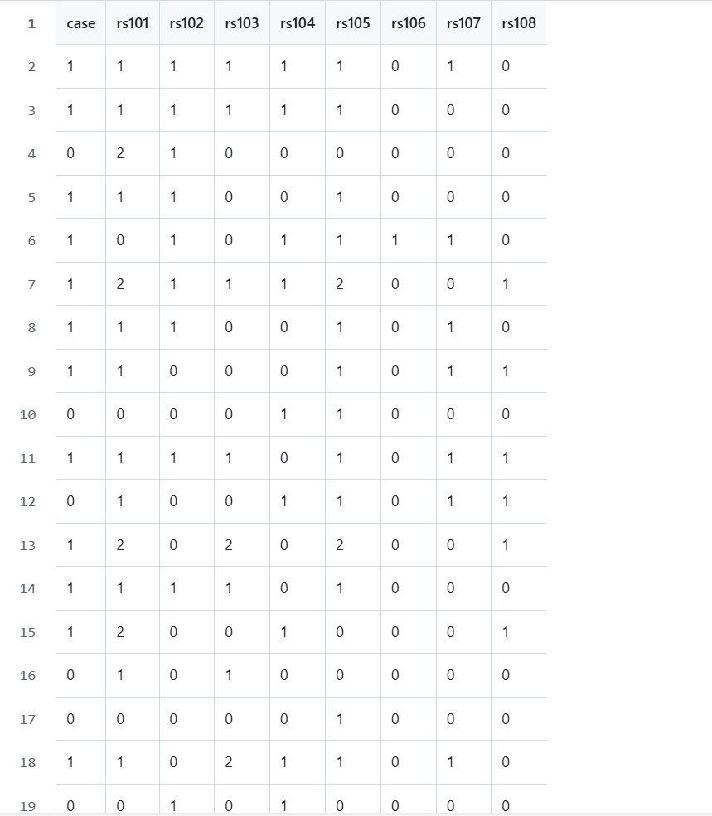
Simulation

Slide 16
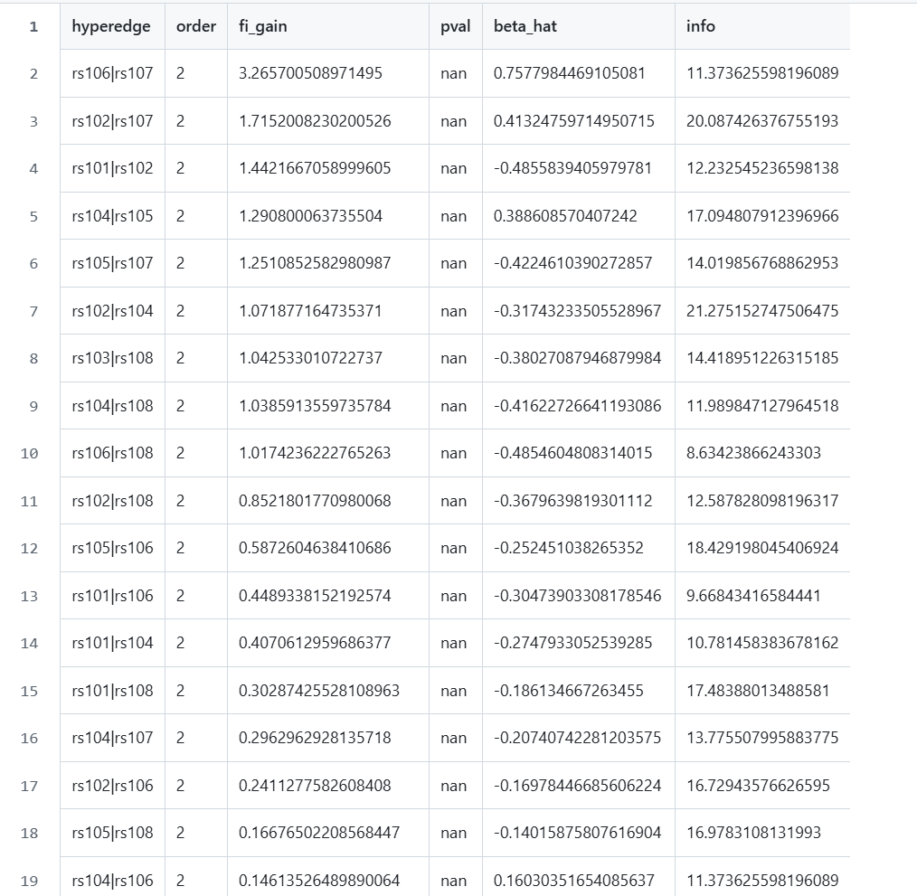
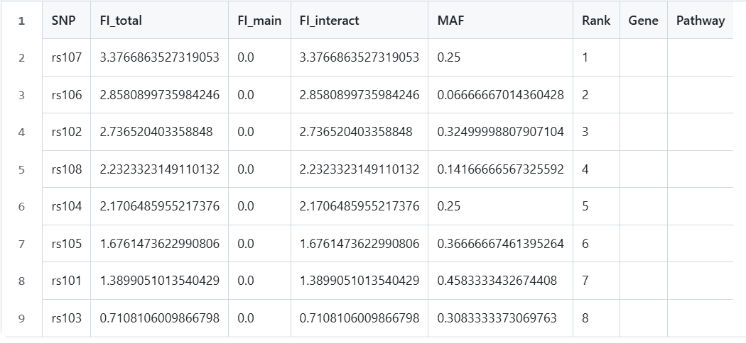
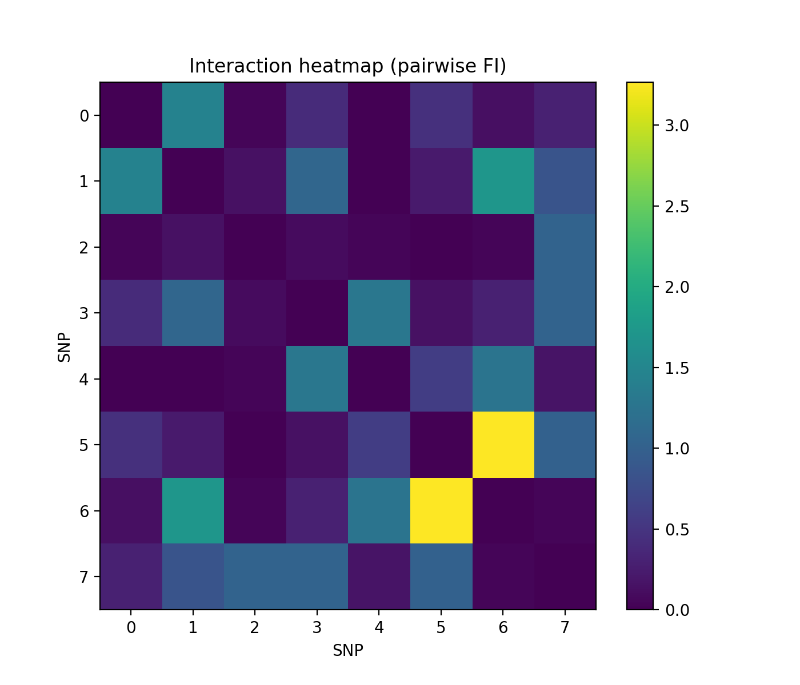
Simulation Example
Notes:
“Notice that even though we allowed up to 4-way interactions, the algorithm only retained 2-way ones — meaning the information surface flattened beyond that. That’s the adaptive stopping in action.”

Slide 17
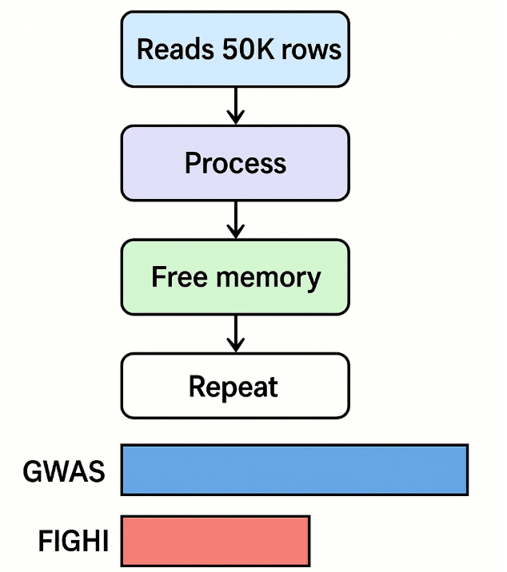
Computational Efficiency
Memory-efficient pipeline.
Notes:
“FIGHI uses a streaming strategy — reading large genotype matrices in chunks, prescreening top variants, and never holding the full dataset in memory. Perfect for biobank-scale data.”

Slide 18

Biological and Theoretical Takeaways
Biological – Captures epistasis efficiently, beyond GWAS main effects.
Mathematical – Based on score test and Fisher Information curvature.
Computational – Scales to large datasets via streaming and pruning.
Notes:
“Every line in FIGHI — every interaction, every edge — is justified by this formula. It tells us which SNP combinations truly make the phenotype landscape bend.”
“That’s it. Every part of FIGHI — theory, computation, and biology — flows from this one equation.”

Slide 19
THANK YOU!
Full FIGHI documentation and code:
https://github.com/1234-Ariel-code/fighi

